Slide 1

NODE #7 WORKSHOP
AUGUST 7-8, 2018 | MONTREAL, CANADA
Modelling Brain Dynamics at Rest
John Griffiths Rotman & Krembil Research Institutes, Toronto
Julie Courtiol Aix-Marseille Université
Notes:
Ok so we’ve had some great introductions in the morning sessions
to the scientific motivations and theoretical background of large scale brain network modelling
and also to the software infrastructure and practical aspects of TVB
I’m going to talk about modelling brain dynamics at rest
and the really my chief aim here is to bring together these two things you’ve learned from the morning session
- the theory and the software interaction
with a few concrete examples of how we understand resting state brain dynamics, and how we go about modelling them

Slide 2


Background
Notes:
- Ok, so now, how do we reproduce this experimental condition?

Slide 3
Overview
MODELLING BRAIN DYNAMICS AT REST Background
Resting state: What & Why?
Dynamics, noise, criticality
Fast dynamics (EEG/MEG/LFP)
Slow (fMRI) dynamics and functional connectivity
Notes:
So we’re going to cover three areas
First I’ll go over some core theoretical concepts
You’ll be familiar with some of this already from Viktor’s talk in the morning;
but will be taking a slightly closer look at some of the nuts and bolts of how we see these ideas in action
Then we’ll look at two flavours of resting state activity that have been studied empirically in neuroimaging
Fast oscillatory activity of the kind measured by EEG, MEG, LFPs and electrophysiology
And then slower fluctuations that we measure with fMRI
And in particular with fMRI we’re interested here in the covariance structure, of functional connectivity
Now these two kinds of data – EEG and MEG – have kinds of information in them, particularly in the temporal structure
So we’ll be using different mathematical models for each that are more suited to each modality
(I should say as well that this isn’t mandatory; it’s straightforward to use the same model for both; we’ll talk more about that later)
But although we use different models, we’re still guided by the same basic ideas;
In particular, there are two core concepts that I want to get across to you:

Slide 4
Overview
MODELLING BRAIN DYNAMICS AT REST Background
Resting state: What & Why?
Dynamics, noise, criticality
Fast dynamics (EEG/MEG/LFP)
Slow (fMRI) dynamics and functional connectivity
Core concepts:
1. Resting state brain activity reflects noisy perturbations to stable/multistable fixed point brain dynamics, in a critical regime, close to a bifurcation
2. Random physiological fluctuations are filtered through local brain dynamics and global network structure to generate dynamic patterns of resting state brain activity and (functional) connectivity
Notes:
Resting state brain activity reflects noisy perturbations to stable/multistable fixed point brain dynamics, in a critical regime, close to a bifurcation
Random physiological fluctuations are filtered through local brain dynamics and global network structure to generate dynamic patterns of resting state brain activity and (functional) connectivtiy
We’ll go over the first of these in some detail in a few slides’ time when we talk about criticality
The second point, I want to just first illustrate with a little cartoon:

Slide 5
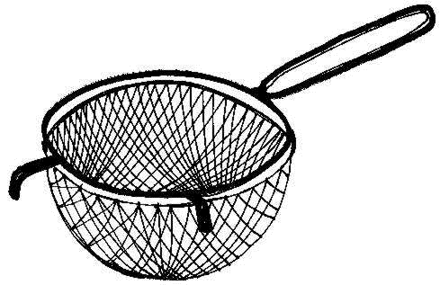
MODELLING BRAIN DYNAMICS AT REST Background
“Random physiological fluctuations are filtered through local brain dynamics and global network structure to generate dynamic patterns of resting state brain activity and (functional) connectivity”
Notes:
So you can think about the system – in our toy model just the two differential equations defining the planar oscillator
…later the system will include both the local dynamics and the network structure
as behaving like a filter
(NEXT)

Slide 6
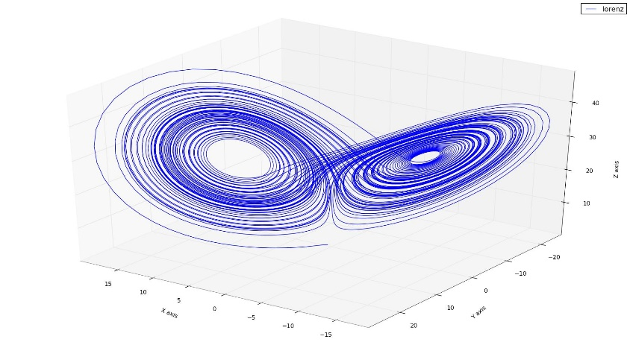
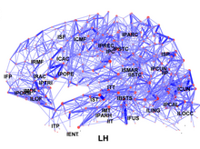
MODELLING BRAIN DYNAMICS AT REST Background
“Random physiological fluctuations are filtered through local brain dynamics and global network structure to generate dynamic patterns of resting state brain activity and (functional) connectivity”
Notes:
(straight on to next slide)

Slide 7
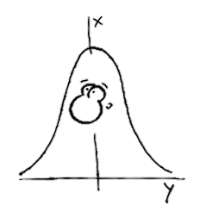
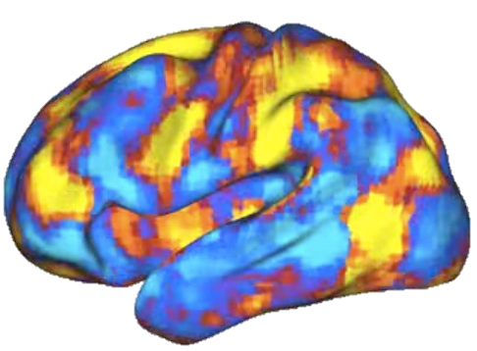
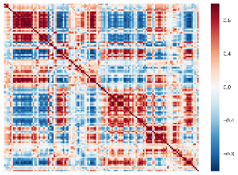
MODELLING BRAIN DYNAMICS AT REST Background
“Random physiological fluctuations are filtered through local brain dynamics and global network structure to generate dynamic patterns of resting state brain activity and (functional) connectivity”
Notes:
Where we have random background physiological fluctuations –
represented here by this nice Gaussian distribution with a smiley face
Are filtered through our system
To generate patterns
What we saw just now was noise being filtered through just the local dynamics , to generate a temporal pattern
What we’ll look at now is the full case where we have noise filtered through both the local dynamics an the network structure,
to generate covariance, or functional connectivity patterns that we measured with fMRI

Slide 8
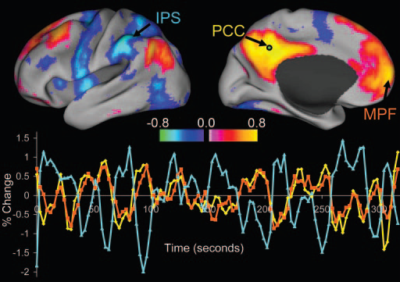
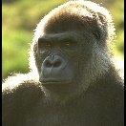
Resting State - What and Why?
MODELLING BRAIN DYNAMICS AT REST Background
Why?
Flexible, easy, practical…etc..
Links to neurocognitive structures
What?
(???)
Internally-directed mentation…
Noise-driven exploration of the brain’s dynamic repertoire
Intrinsic correlations between a seed region in the PCC and all other voxels in the brain
for a single subject during resting-fixation.
Fox et al. PNAS 2005; Vincent et al. Nature 2007; Smith et al. PNAS 2009
Notes:
…But I think a more interesting answer to the why question s that they also have non-trivial links to neurocognitive structures –
Here is an example from a study by Steve Smith and colleagues in 2009
On the top row you have some canonical resting state networks, identified from group ICA on resting state scans
On the bottom row, components from an ICA of activation maps from a meta-analysis database
And what they found was that for each resting state network, they could find a corresponding component representing
neurocognitive systems activated for specific tasks
So this was one early indication – and there’s been plenty more since – that there’s something particularly interesting about
these resting state brain patterns;
they contain inside them this fingerprint, or echo, of ‘cognitive’ brain activity.

Slide 9
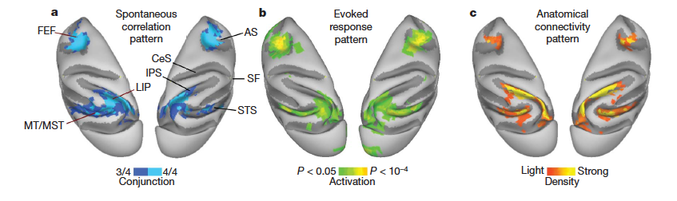
Resting State - What and Why?
MODELLING BRAIN DYNAMICS AT REST Background
Why?
Flexible, easy, practical…etc..
Links to neurocognitive structures
What?
(???)
Internally-directed mentation…
Noise-driven exploration of the brain’s dynamic repertoire
Cortical patterns of coherent spontaneous BOLD fluctuations are similar to those of task-evoked responses and anatomical connectivity.
Fox et al. PNAS 2005; Vincent et al. Nature 2007; Smith et al. PNAS 2009
Notes:
…But I think a more interesting answer to the why question s that they also have non-trivial links to neurocognitive structures –
Here is an example from a study by Steve Smith and colleagues in 2009
On the top row you have some canonical resting state networks, identified from group ICA on resting state scans
On the bottom row, components from an ICA of activation maps from a meta-analysis database
And what they found was that for each resting state network, they could find a corresponding component representing
neurocognitive systems activated for specific tasks
So this was one early indication – and there’s been plenty more since – that there’s something particularly interesting about
these resting state brain patterns;
they contain inside them this fingerprint, or echo, of ‘cognitive’ brain activity.

Slide 10
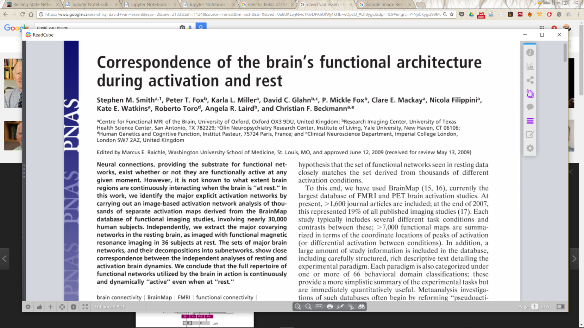
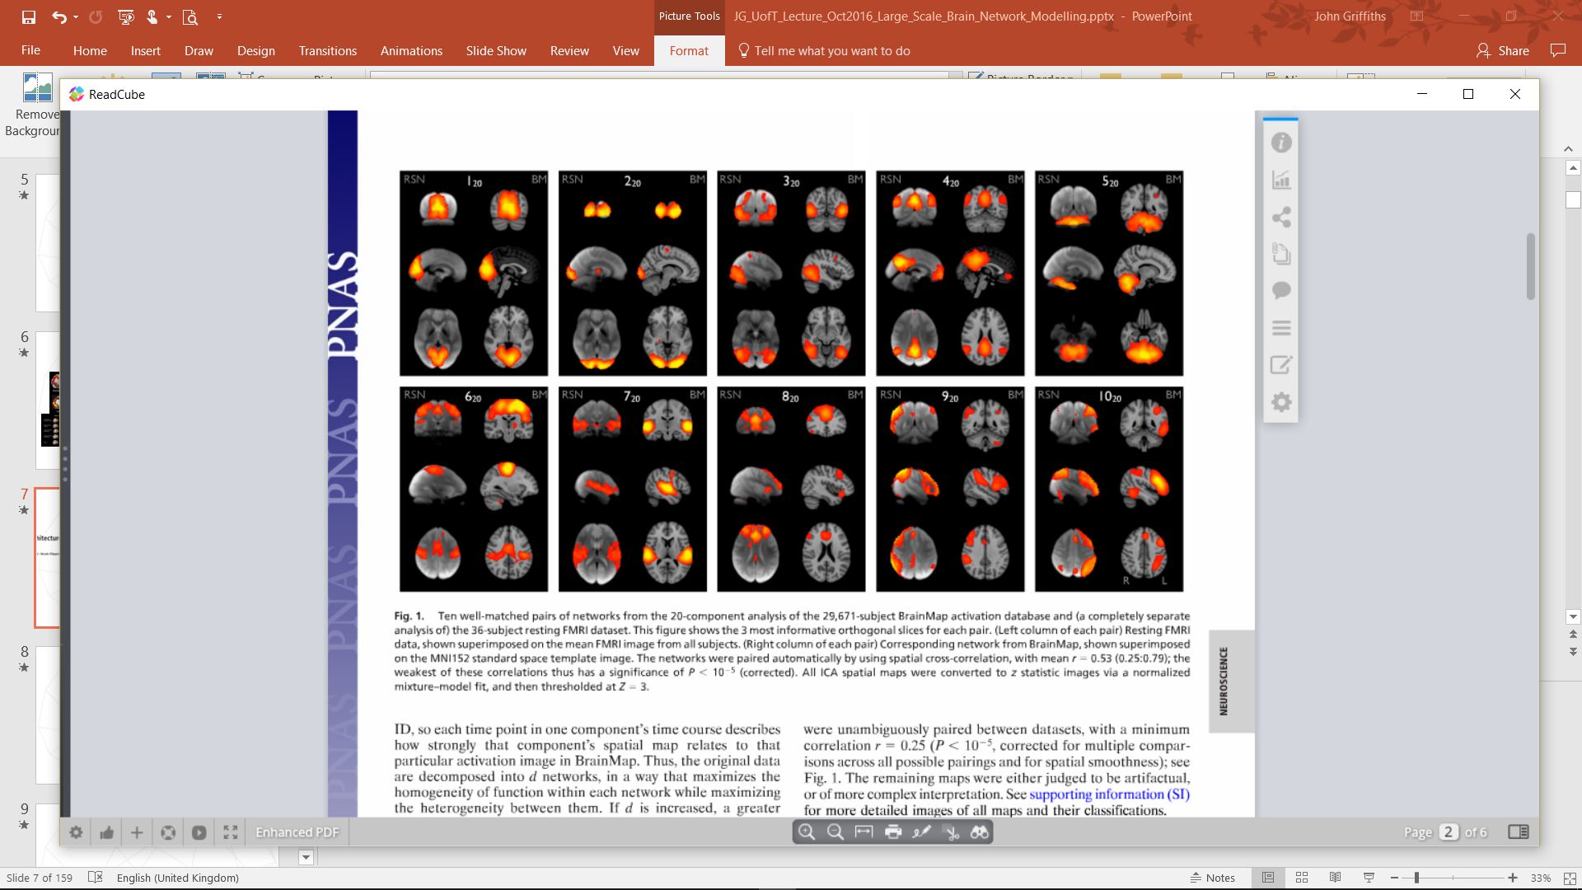
Resting State - What and Why?
MODELLING BRAIN DYNAMICS AT REST Background
Why?
Flexible, easy, practical…etc..
Links to neurocognitive structures
What?
(???)
Internally-directed mentation…
Noise-driven exploration of the brain’s dynamic repertoire
Cortical patterns of coherent spontaneous BOLD fluctuations are similar to those of task-evoked responses and anatomical connectivity.
rsfMRI spatial component maps match cognitive task activation meta-analysis spatial component maps
Fox et al. PNAS 2005; Vincent et al. Nature 2007; Smith et al. PNAS 2009
Notes:
…But I think a more interesting answer to the why question s that they also have non-trivial links to neurocognitive structures –
Here is an example from a study by Steve Smith and colleagues in 2009
On the top row you have some canonical resting state networks, identified from group ICA on resting state scans
On the bottom row, components from an ICA of activation maps from a meta-analysis database
And what they found was that for each resting state network, they could find a corresponding component representing
neurocognitive systems activated for specific tasks
So this was one early indication – and there’s been plenty more since – that there’s something particularly interesting about
these resting state brain patterns;
they contain inside them this fingerprint, or echo, of ‘cognitive’ brain activity.

Slide 11
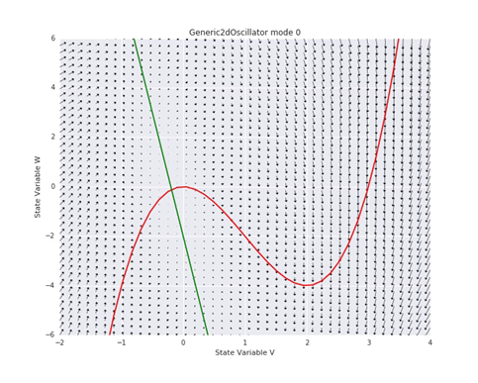
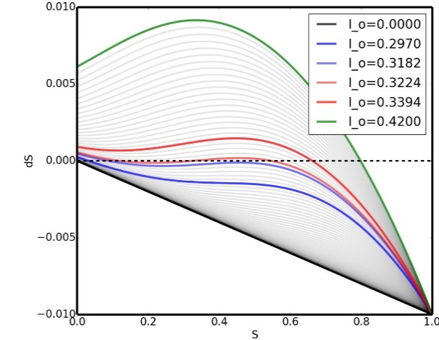
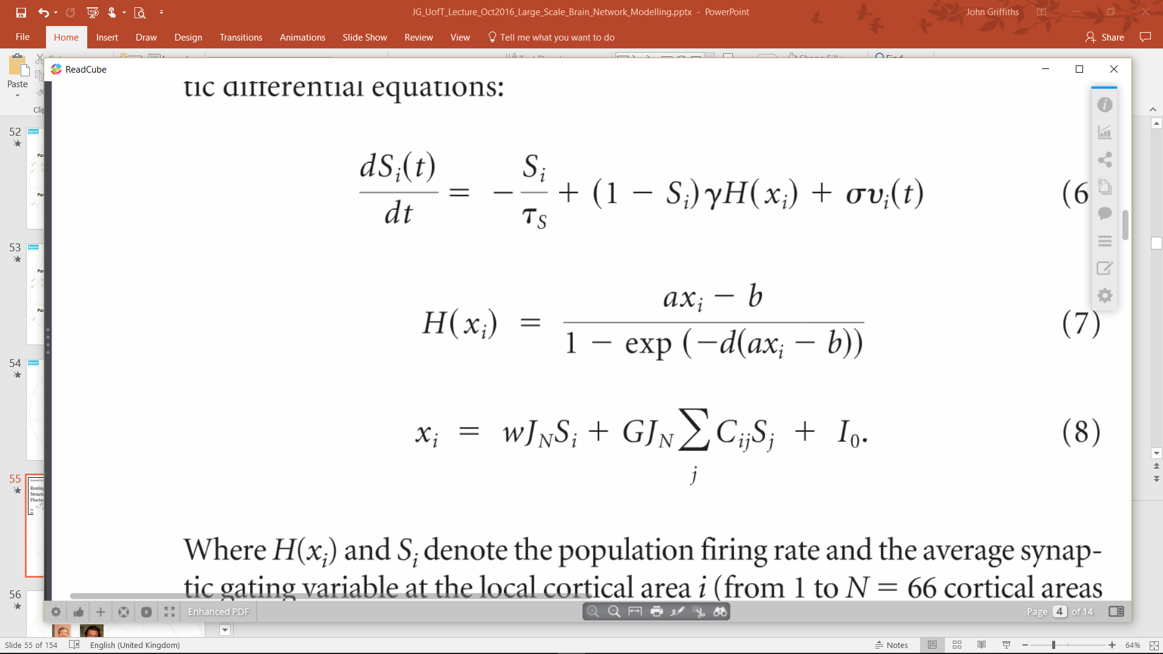
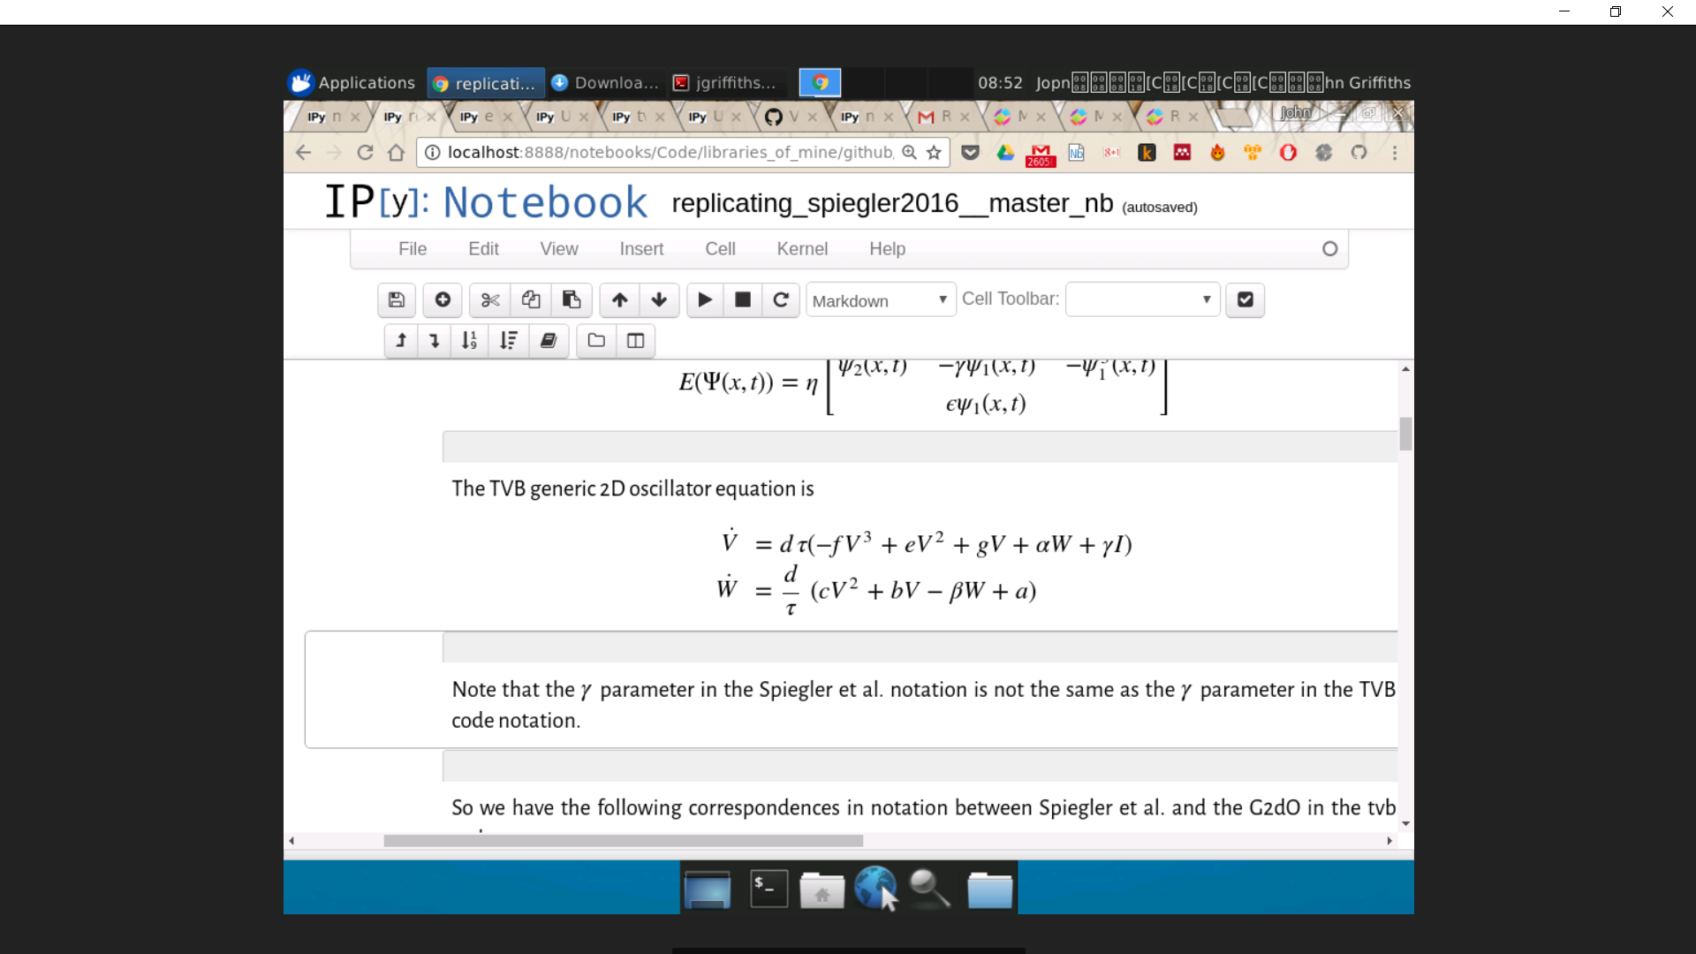
This session’s models:
MODELLING BRAIN DYNAMICS AT REST Background
Generic 2D Oscillator (G2DO) /
Fitzhugh-Nagumo (FHN)
Reduced Wong-Wang (RWW) /
Wong-Wang-Deco

Slide 12
Dynamics, Noise,
& Criticality
Notes:
- Ok, so now, how do we reproduce this experimental condition?

Slide 13
Generic 2D Oscillator / FHN Model
MODELLING BRAIN DYNAMICS AT REST Dynamics, Noise, & Criticality
Fithugh-Nagumo (FHN) model is a reduction of Hodgkin-Huxley
G2DO is a generalization of FHN ( + related models)
V = fast membrane potential
W = slow restorative current
Notes:
So now we want to illustrate the first of our core conceptual points; namely that
Resting state brain activity reflects noisy perturbations to stable/multistable fixed point brain dynamics, in a critical regime, close to a bifurcation
…using a very simple model
A 2-D planar oscillator model
That’s described here by these equations – we have two state variables, V and W
V has cubic and quadratic nonlinearities –
And a couple And a couple of linear coefficients here
V has cubic, quadratic, and linear dependence on itself; linear dependence on W, as well as this background excitability parameter or input I
W has quadratic and linear dependence on V; linear depdendence on itself; and a constant
And finally we have this time scale separation between the fast and slow variables introduced by the time constant tau
This d/tau makes W evolve more slowly than V; the time-scale difference is determined by tau
So this is a generic-2D oscillator model that we use in TVB;
For present purposes you can basically think of it as a Fitzhugh-nagumo model (classic 2D reduction of 4D hodgin-Huxley equations)
Because I’m going to set a lot of these coefficients to zero (quadratic terms here nad here; self-dependence of W on W; etc.
And basically reduce this to a Fitzhugh-nagumo model
This is the phase plane – we have the fast variable V on the X axis; slow variable W on the Y axis;
The red line is the nullcline for the fast variable;
Nullcline being the values of V and W for which the derivative of V is zero
we retained the cubic term so it has this wiggly N shape
The green line is the nullcline for the slow variable; we just kept the linear term in there so it’s juts a straight line
And the intersection of the two is a stable fixed point.

Slide 14



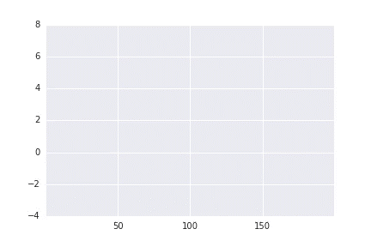
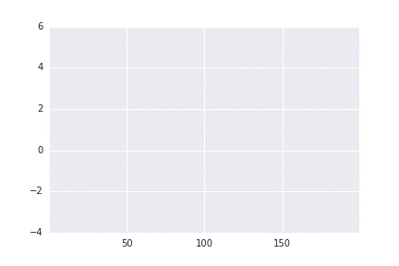
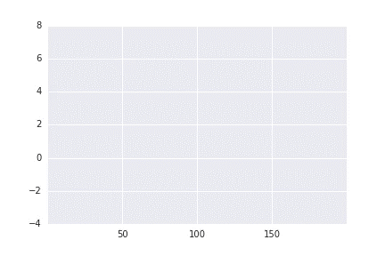
MODELLING BRAIN DYNAMICS AT REST Dynamics, Noise, & Criticality
Core concepts:
1. Resting state brain activity reflects noisy perturbations to stable/multistable fixed point brain dynamics, in a critical regime, close to a bifurcation
2. Random physiological fluctuations are filtered through local brain dynamics and global network structure to generate dynamic patterns of resting state brain activity and (functional) connectivity
Stable (fixed point)
Stable (limit cycle)
Noisy, subcritical
Notes:
Click left top and left bottom. Describe phase plane evolution vs, time series in general; and in this specific case we see a perturbation / initial condition, and then settling / damped wave, on to the fixed point
Click middle top and middle bottom: same thing, but now we have increased self-feedback, and we move system through a hopf bifurcation into self-sustained oscillations
Click right top and right bottom: now params same as the first , but we use stochastic integration scheme. See rich, noisy, quasi-periodic flucutations…

Slide 15
M/EEG Modelling
Notes:
- Ok, so now, how do we reproduce this experimental condition?

Slide 16
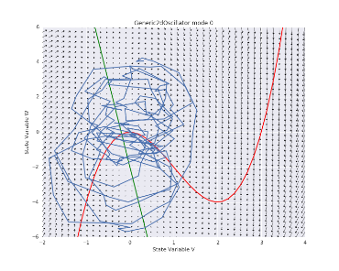
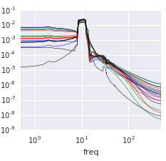
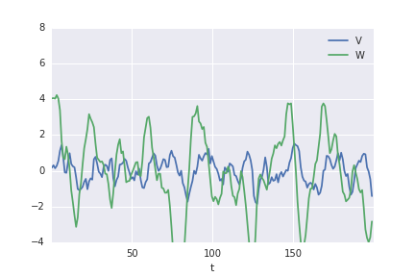
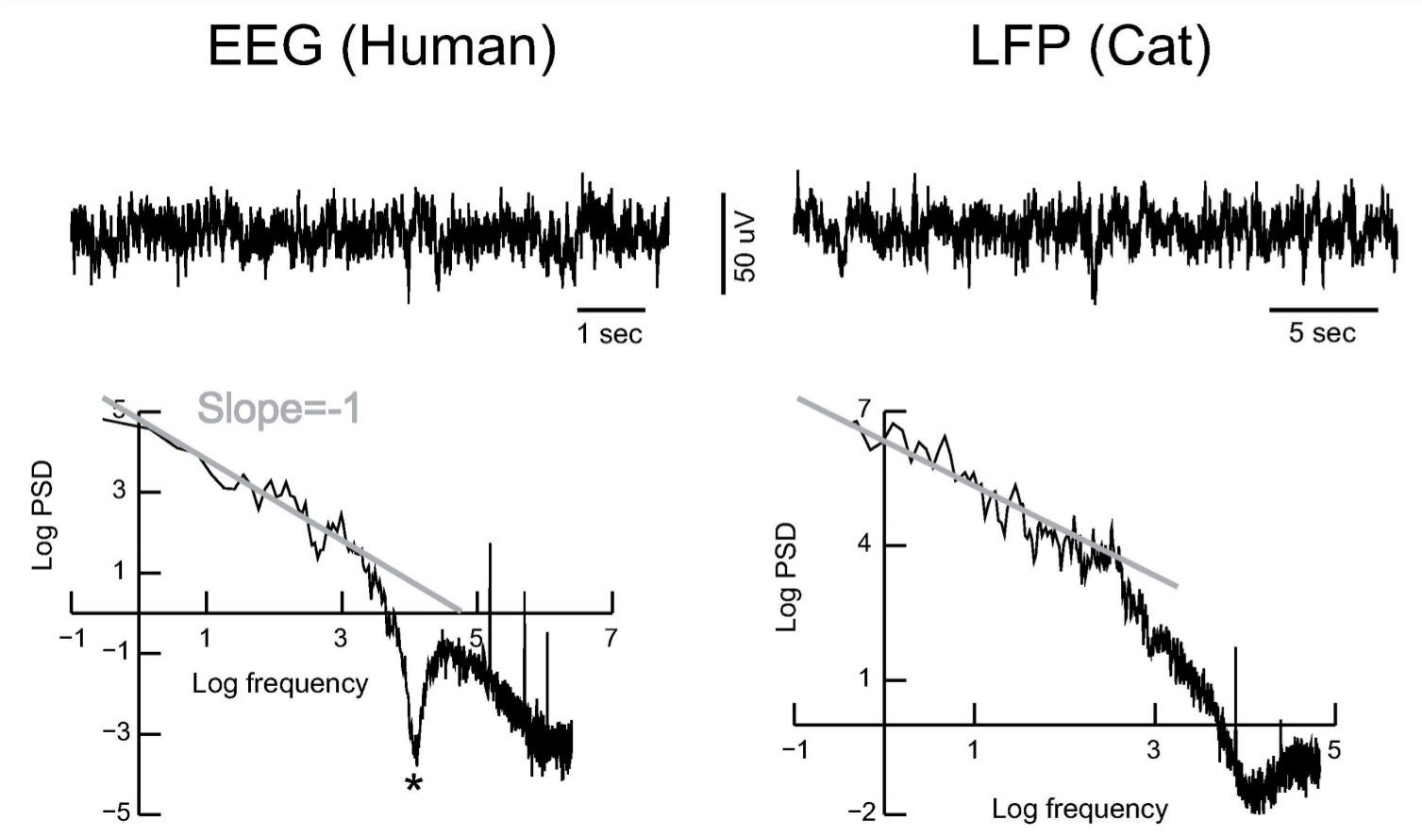
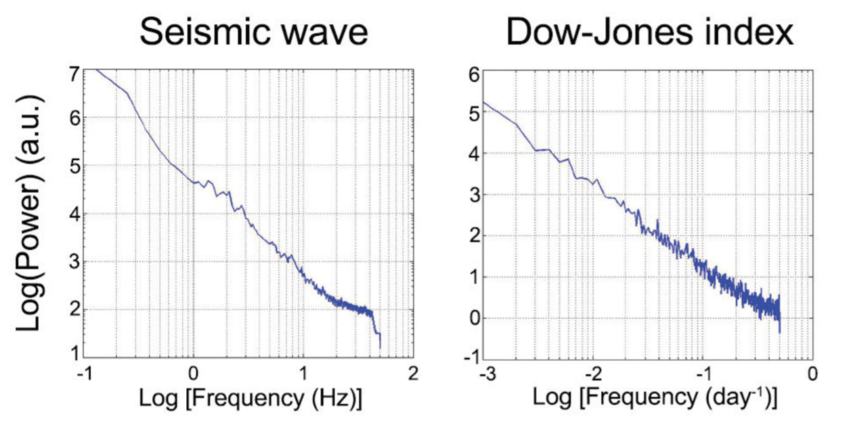
M/EEG Power spectrum
MODELLING BRAIN DYNAMICS AT REST rsM/EEG modelling
2 principal features of M/EEG & LFP power spectrum:
Dominant frequency (alpha, gamma): local + global resonances
Power law exponent: critical fluctuations

Slide 17

Qs?

Slide 18
Interlude: An orientation to the code
Github organization:
https://github.com/the-virtual-brain
Most important things live in
https://github.com/the-virtual-brain/tvb-library/tree/trunk/tvb/simulator

Slide 19
rsfMRI Modelling
Notes:
- Ok, so now, how do we reproduce this experimental condition?

Slide 20
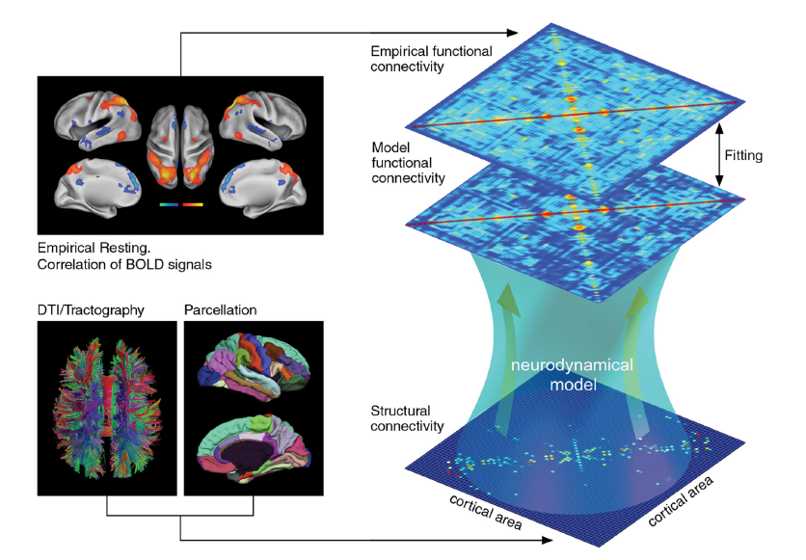
General Approach
MODELLING BRAIN DYNAMICS AT REST rsfMRI modelling
Deco, Ponce-Alvarez et al. JofNeurosci 2013
Notes:
The general approach, we know so far, for modeling the resting-state is the following:
So first, we translate this anatomical connectivity, that we get from the DTI and T1 scans of the subject, into a matrix which is defined by the set of all existing connections between brain areas,
Then, we introduce an intrinsic activity by a neurodynamical model
And now, we see if this global dynamic is shaped in the form of a functional connectome,
functional connectivity is a set of relationships between brain areas, the relationships depend of the metric you choose to characterize the functional connections between areas. The most commonly used is the cross-correlation or covariance measure.
so we are looking if we generate a functional connectome that correspond to the functional correlations we observe in the scanner at the level of BOLD correlation signals
and then, you compare these two matrices and fit, optimize your parameters when comparing it to the empirical FC matrix.

Slide 21

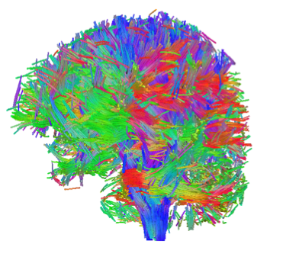
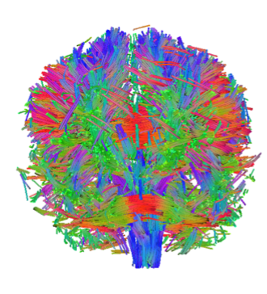
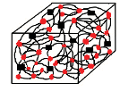
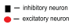


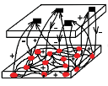
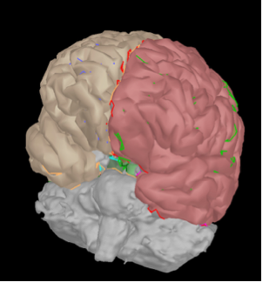
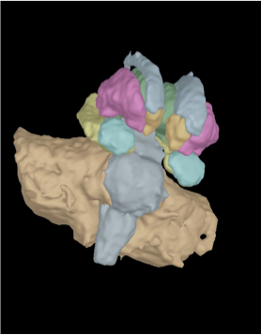
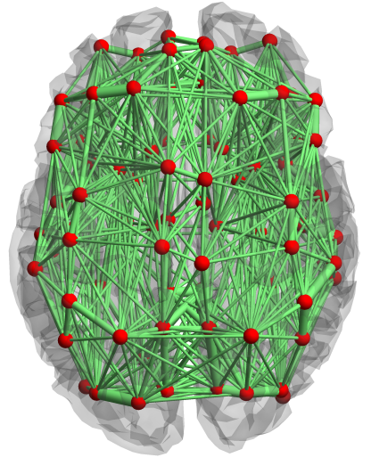
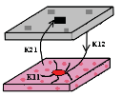
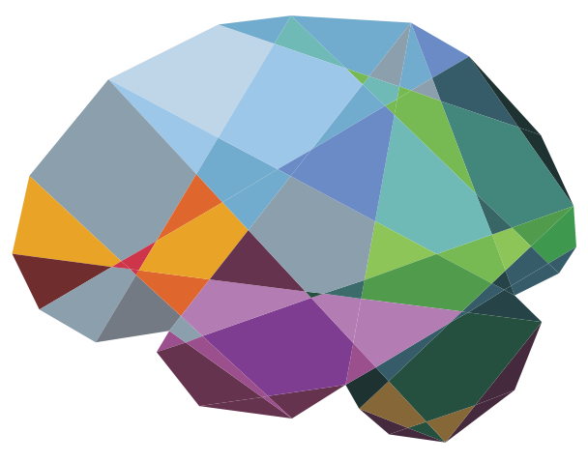
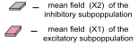
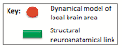
MODELLING BRAIN DYNAMICS AT REST rsfMRI modelling
General Approach
connectivity from DTI.
input
neural mass model.
topography from MRI.
Sanz-Leon et al. Front.Neuroinform 2013, Neuroimage 2015
Notes:
This general approach is also the one we use in TVB:
you load in your connectivity matrix, you built your parcellation and the geometry of the cortex, basically you built your brain model
put in your neural mass model on each brain area
note: So most of these modelling studies have performed drift region-based modeling rather than surface modeling.
then you run your model…

Slide 22

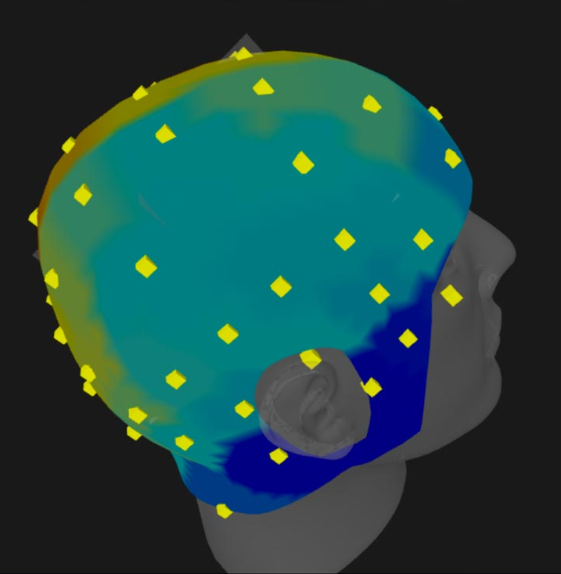
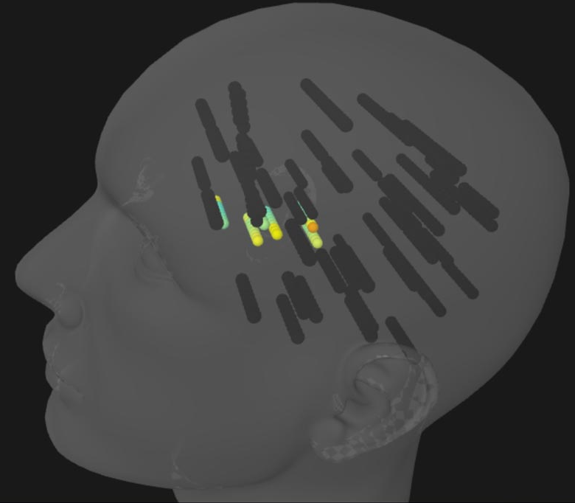
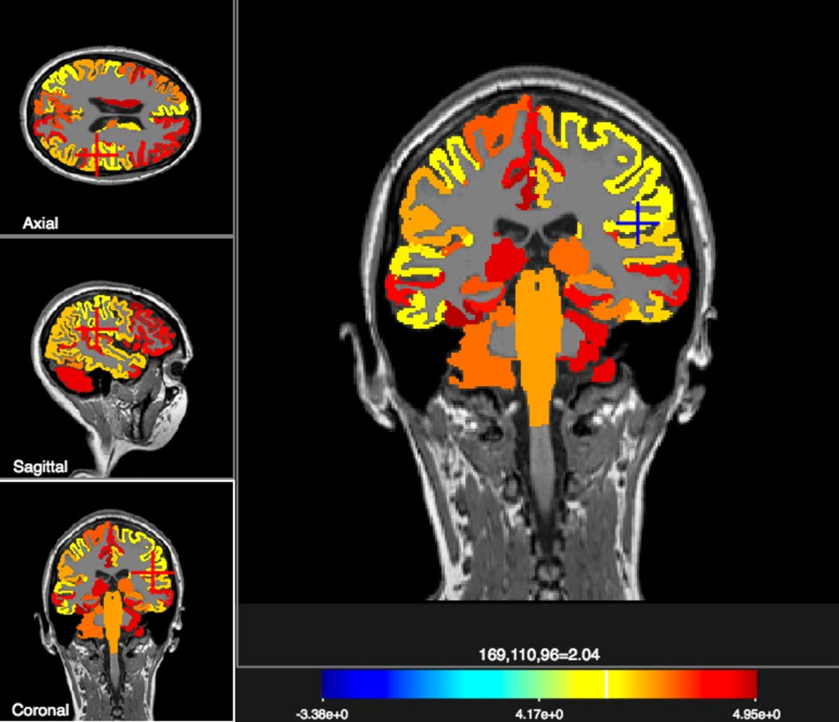
MODELLING BRAIN DYNAMICS AT REST rsfMRI modelling
General Approach
Neuronal activity
Neuroimaging
EEG, SEEG, MEG
fMRI BOLD
local field potential
synaptic activity
firing rate
output
Sanz-Leon et al. Front.Neuroinform 2013, Neuroimage 2015
Notes:
… and you get your time series out of the neural mass it can be LFP or firing rate, it depends of your neural mass model
using the Balloon-Windkessel model, which is implemented, it gives you the BOLD signal,
and then you start comparing to the empirical data.
so mentioning the non-stationarity has been a big issue, and the FC matrices are typically not fit to capture these non-stationarities but study the models help us a lot to understand the nature of the non-stationarity behavior within the resting-state and has told us how to change our analysis in order to get a better deep understanding of the resting-state activity and the non-stationarity is present in functional connectivity
the non-stationarity is also present in the models

Slide 23

Models proposed for rsfMRI
MODELLING BRAIN DYNAMICS AT REST rsfMRI modelling
Phenomenologic | Generic 2D | Kuramoto | Linear
Biologically realistic | Wilson-Cowan Jansen-Rit Zetterberg-Jansen | Stefanescu-Jirsa 2D-3D Larter-Breakspear Hopfield | Wong-Wang & Deco
*
*
*
chaotic dynamic systems
EEG, SEEG, MEG
fMRI BOLD
*
*
*
*
biophysically realistic
*
*
*
Sanz-Leon et al. Front.Neuroinform 2013, Neuroimage 2015

Slide 24

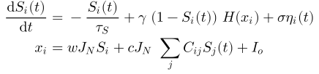
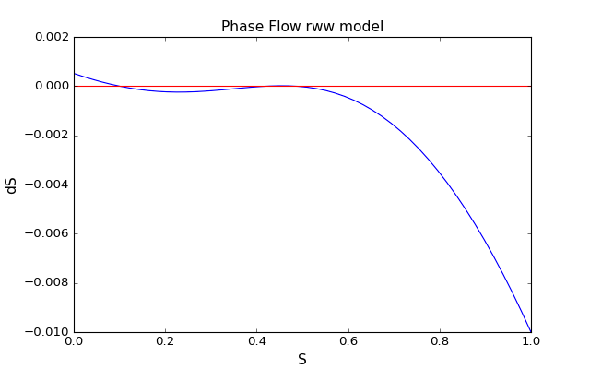
MODELLING BRAIN DYNAMICS AT REST rsfMRI modelling
Reduced Wong-Wang (a.k.a. WWD, DMF) model
where
average synaptic gating var.
sigmoid function that converts the input synaptic activity
into an output population firing rate function
Why?
biologically realistic
synaptic activity output
1 dimensional flow
used in literature and published
no time-delays
in this case
Deco et al. JN 2013, 2014; Hansen et al. NI 2015

Slide 25

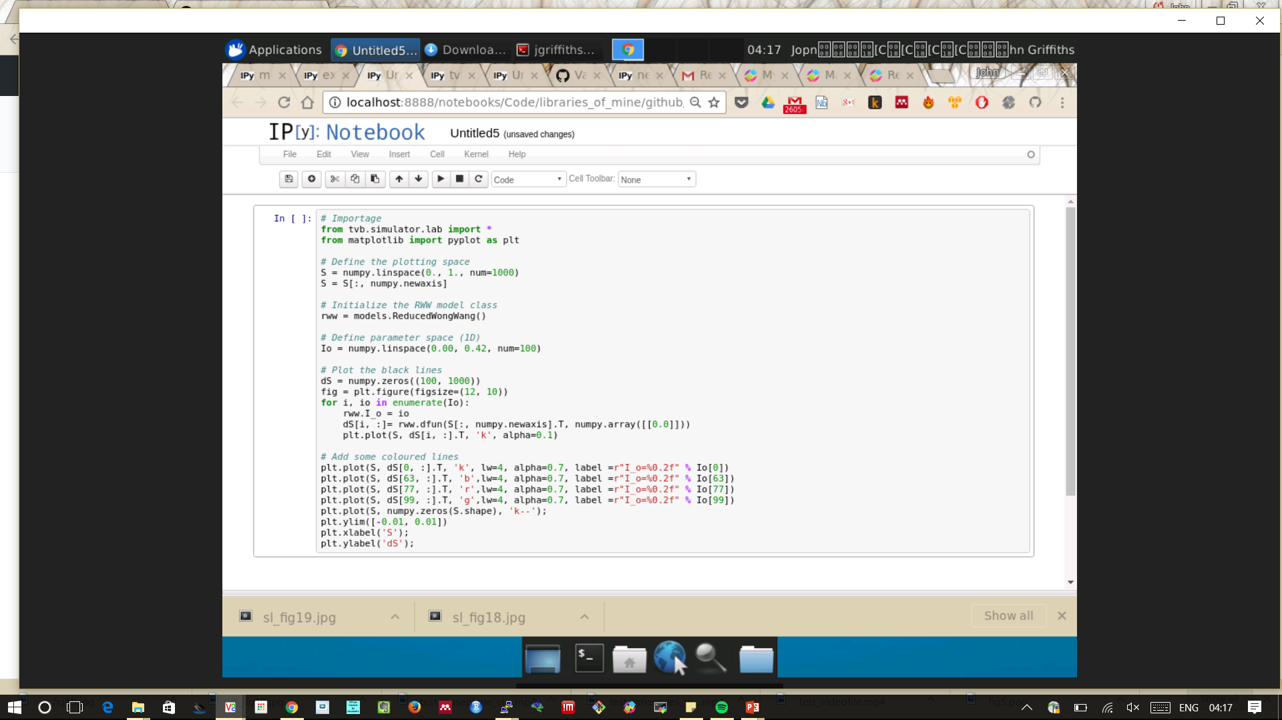
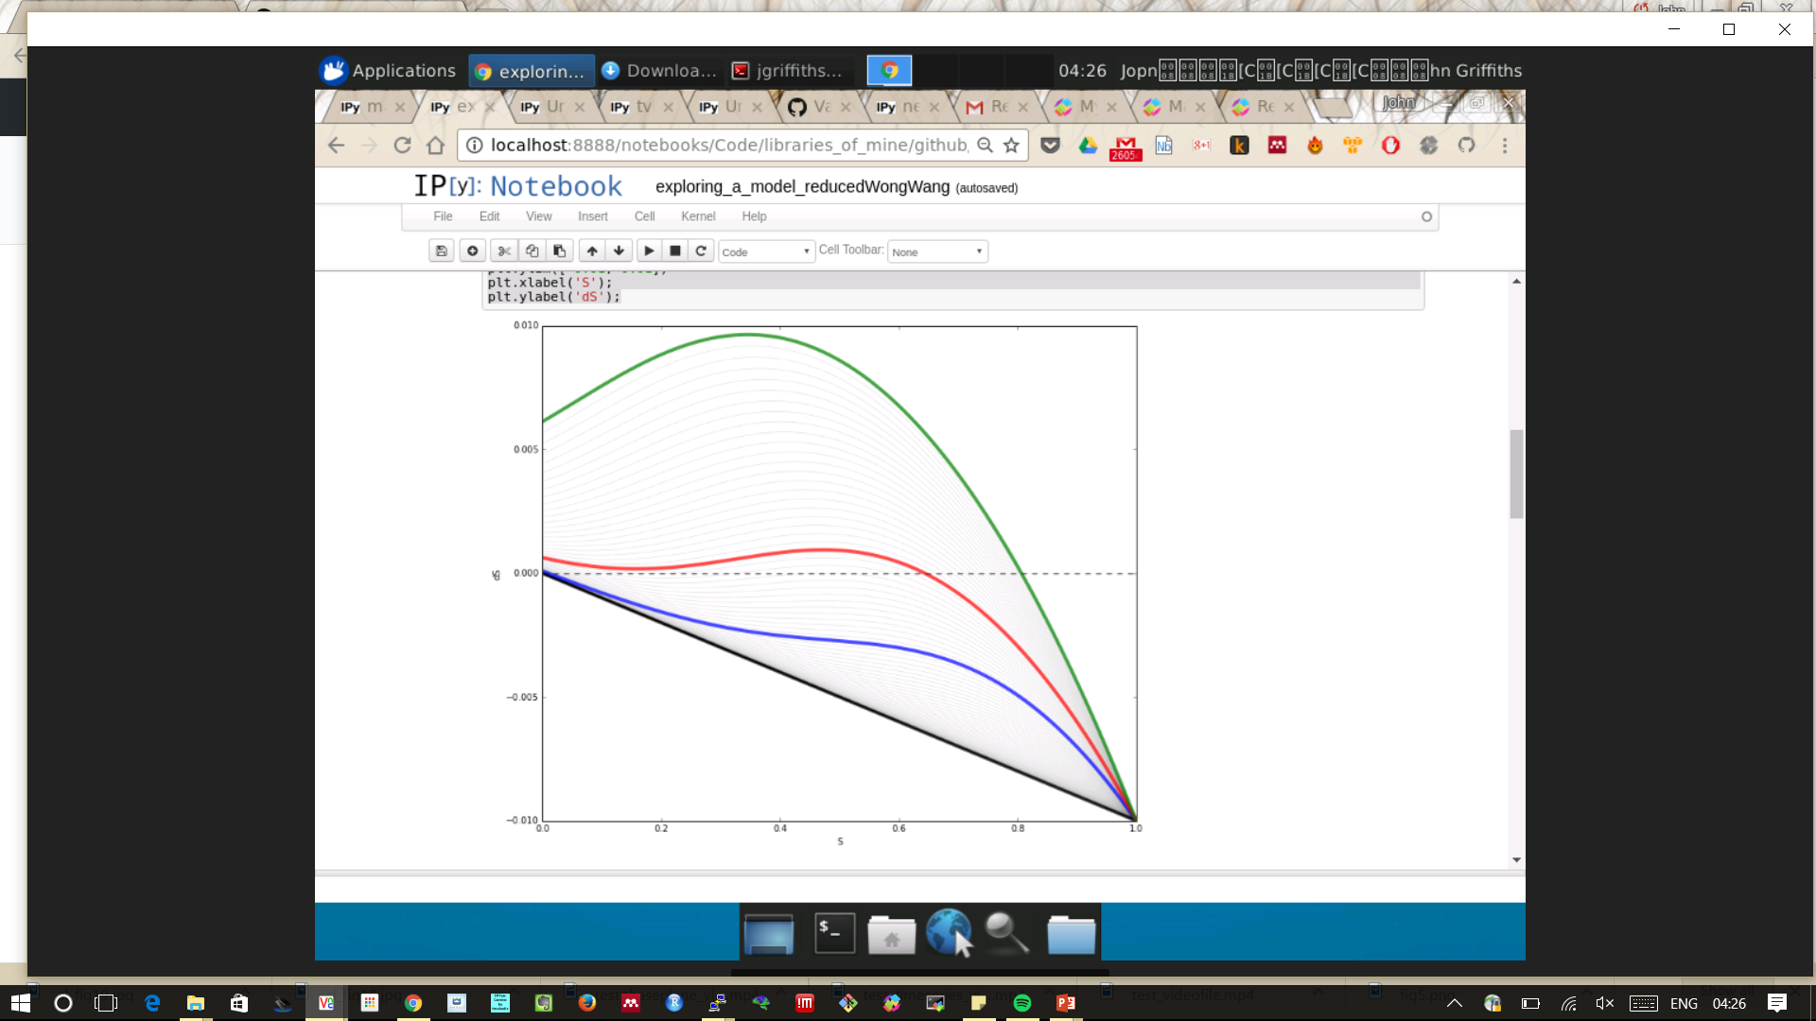
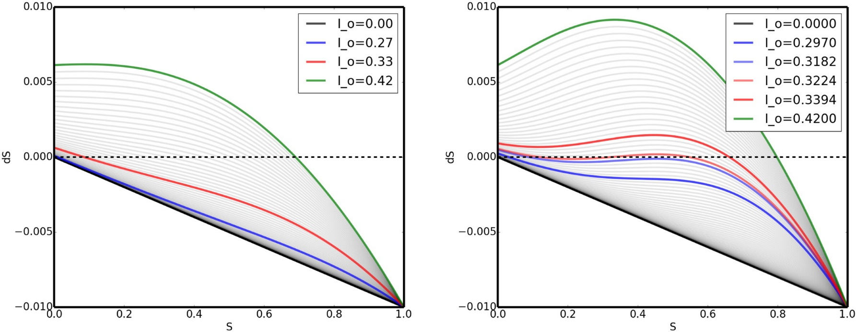
MODELLING BRAIN DYNAMICS AT REST rsfMRI modelling
Reduced Wong-Wang (a.k.a. WWD, DMF) model
Sanz-Leon et al. 2015

Slide 26
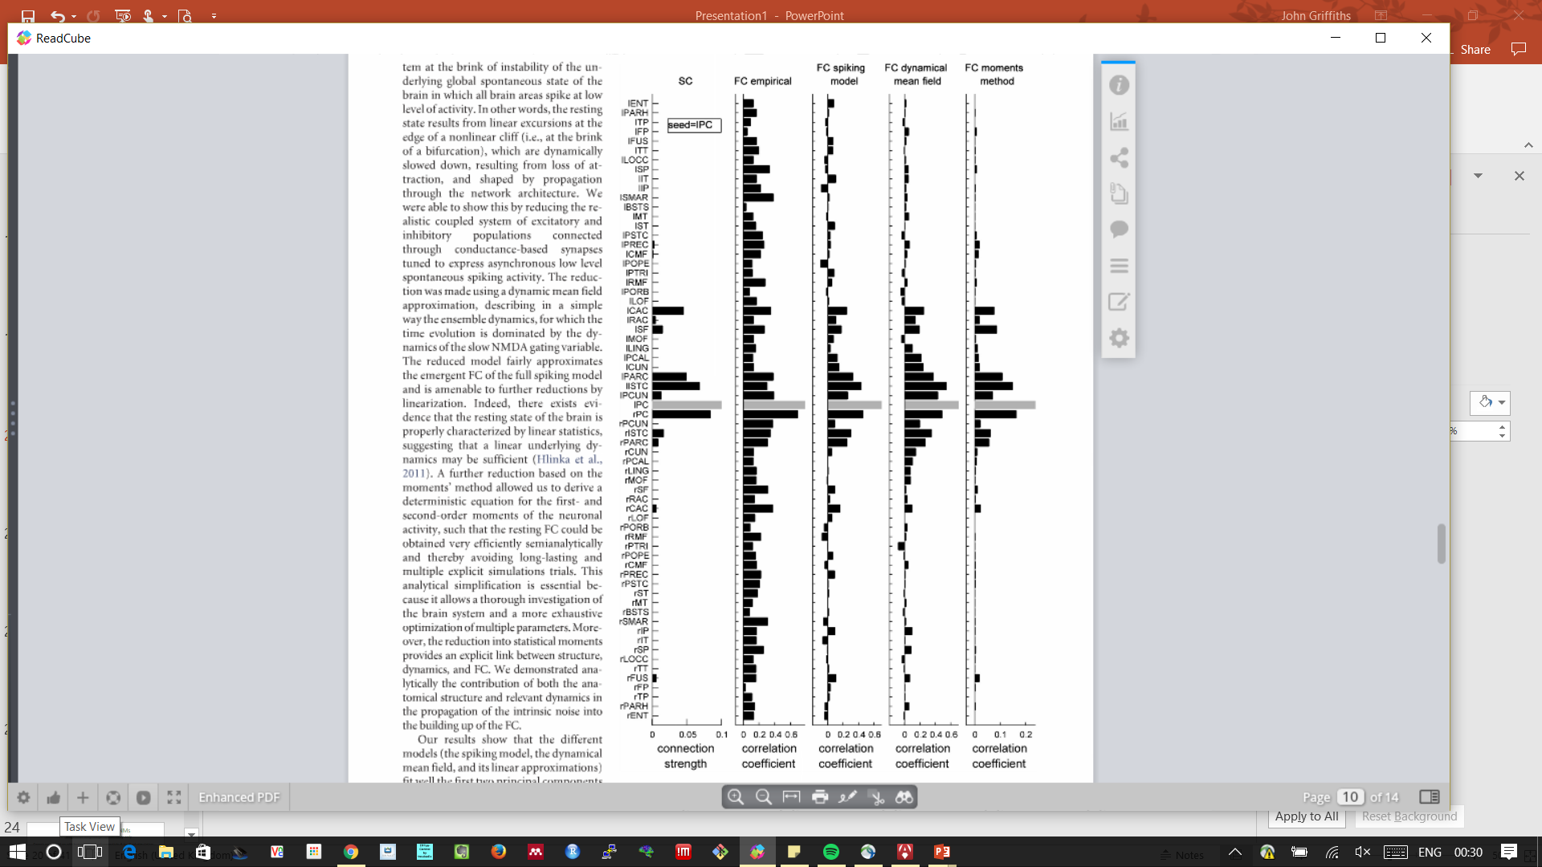
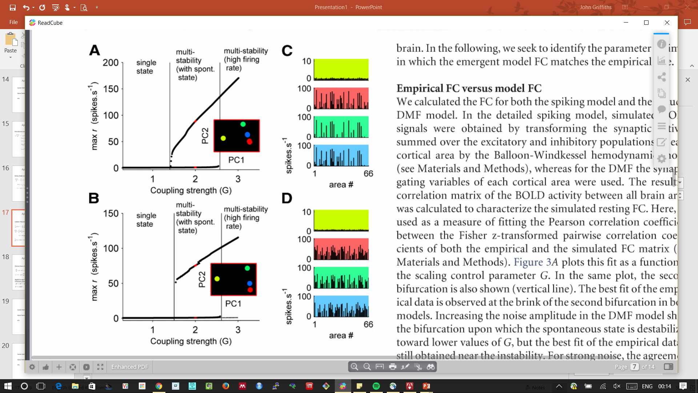
MODELLING BRAIN DYNAMICS AT REST rsfMRI modelling
Deco-Jirsa RS Bifurcation Theory
Bifurcation diagrams for spiking & reduced models
Correlation Fingerprint for IPC Seed
Deco et al. JN 2013

Slide 27
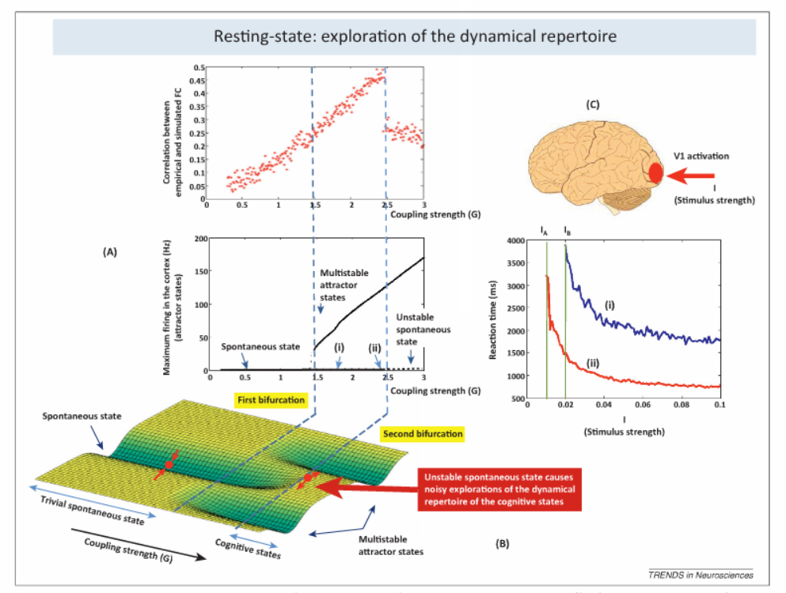
MODELLING BRAIN DYNAMICS AT REST rsfMRI modelling
Deco-Jirsa RS Bifurcation Theory
Low global coupling: spontaneous low firing rate is stable
First bifurcation: multistability
Second bifurcation: spontaneous state loses stability
Resting state FC structure is at edge of second bifurcation
This is optimal for information processing
Deco et al. TICS 2013; Deco et al. JN 2013

Slide 28
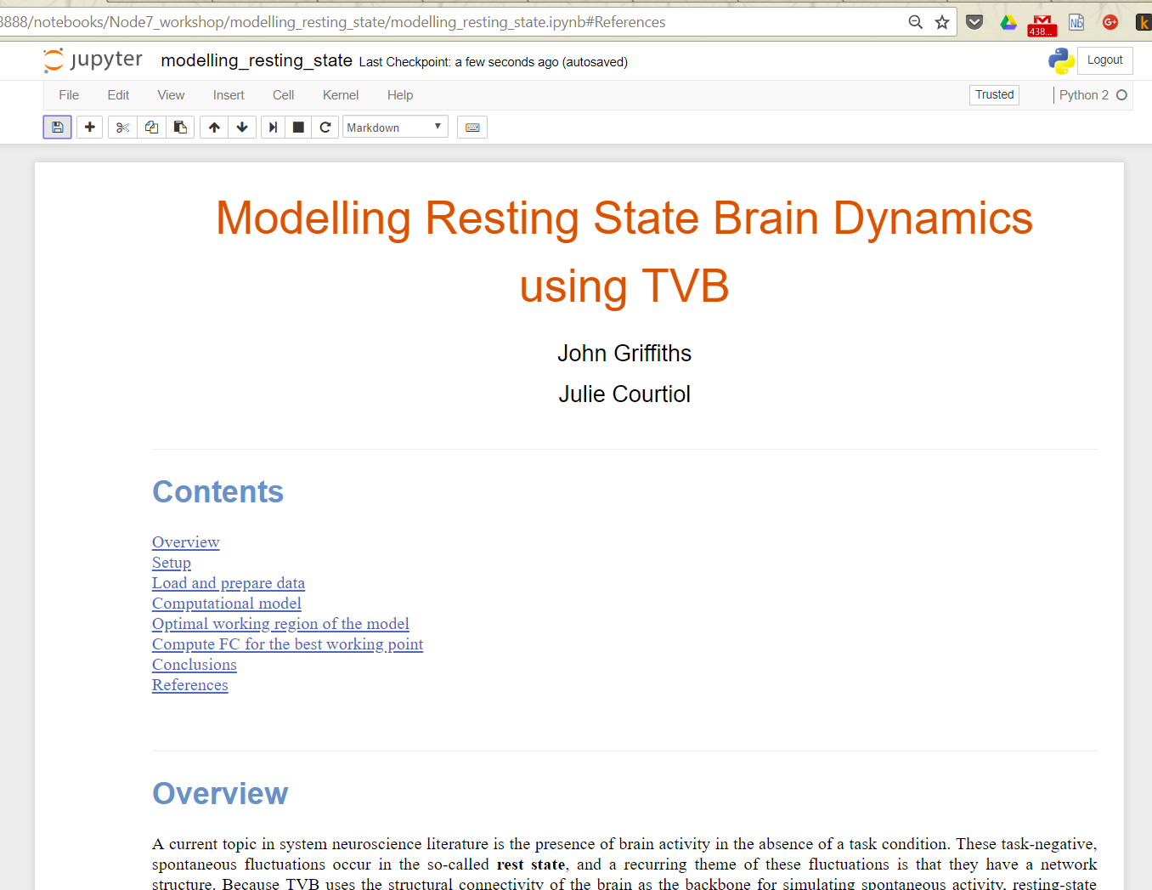
Replicating Deco et al. 2013
MODELLING BRAIN DYNAMICS AT REST rsfMRI modelling

Slide 29
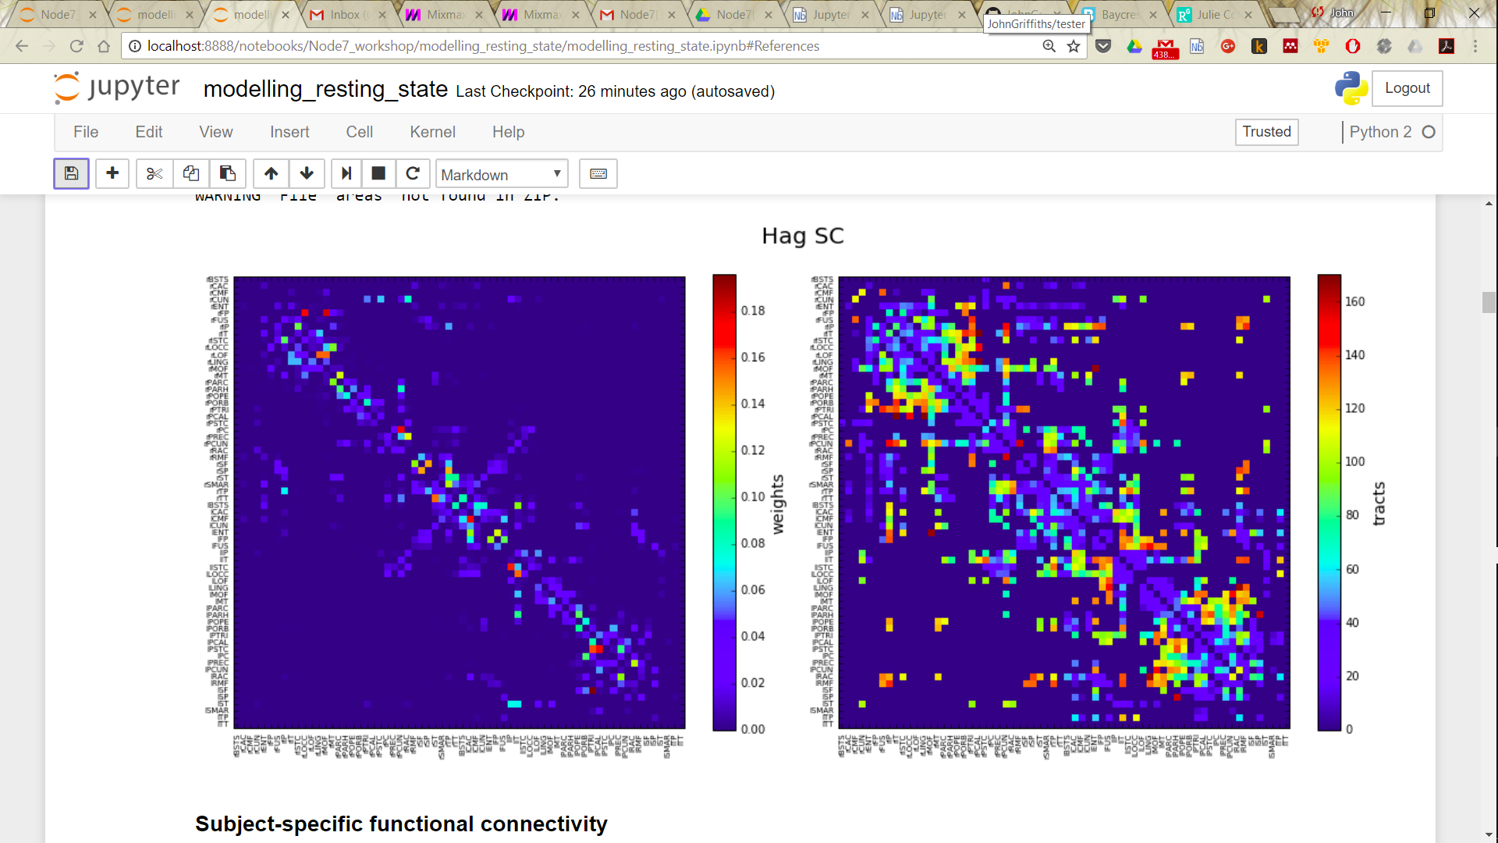
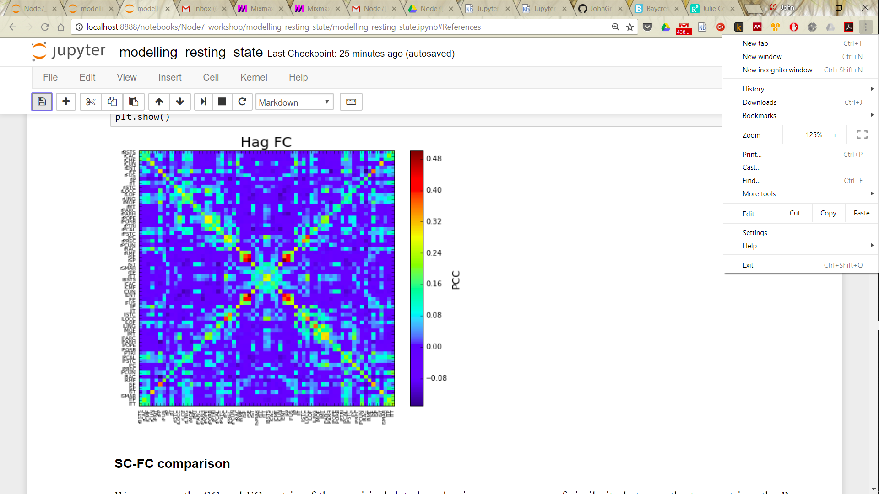
Replicating Deco et al. 2013
MODELLING BRAIN DYNAMICS AT REST rsfMRI modelling
Structural Connectivity
Functional Connectivity

Slide 30
RWW model phase plane
MODELLING BRAIN DYNAMICS AT REST rsfMRI modelling

Slide 31





Bifurcation diagram
MODELLING BRAIN DYNAMICS AT REST rsfMRI modelling
low act.
single
state
50
Max H (spikes.s )
high act.
multi-stability
(with spont. state)
multi-stability
(high firing rate)
multi act.
10
0
0
1
2
3
coupling strength (c)
Deco et al. JN 2013, 2014; Hansen et al. NI 2015
Notes:
why H for the bif diag???
-> go into interface
We first calculate the bifurcation diagram characterizing the stationary state of the brain system as a function of a single control parameter: the global coupling G, describing the scaling or global strength of the inter-cortical coupling.
For small values of the global coupling G, only one stable state exists, characterizing by a low firing activity in all cortical areas. For a critical value of G=0.6, a first bifurcation emerges where new multistable states of high activity appear while the state of low activity is still stable. For even larger values of G (G >= 2.1), a second bifurcation appears where the state of low activity becomes unstable.
- In the following, we seek to identify the parameter regimen in which the emergent model FC matches the empirical one.

Slide 32

Bifurcation diagram
MODELLING BRAIN DYNAMICS AT REST rsfMRI modelling
export
firing rate
H
initial
conditions

Slide 33




MODELLING BRAIN DYNAMICS AT REST rsfMRI modelling
Functional connectivity (FC)
50
Max H (spikes.s )
Bifurcation line
10
best fit
0
0.25
Corr [FCemp, FCsim]
0.05
Resting-state emerges at the edge of the bifurcation
0.00
0
1
2
3
coupling strength (c)
Deco et al. JN 2013, 2014; Hansen et al. NI 2015
Notes:
+ link to Meysam’s talk

Slide 34
Summary
MODELLING BRAIN DYNAMICS AT REST rsfMRI modelling

Slide 35

Summary
MODELLING BRAIN DYNAMICS AT REST rsfMRI modelling
Core concepts:
1. Resting state brain activity reflects noisy perturbations to stable/multistable fixed point brain dynamics, in a critical regime, close to a bifurcation
2. Random physiological fluctuations are filtered through local brain dynamics and global network structure to generate dynamic patterns of resting state brain activity and (functional) connectivity
Wise man look at phase plane often
Github is your friend

Slide 36
THANK YOU
Notes:
Waiting to be silence in the room..
<date/time>
36

Slide 38

More stuff…
MODELLING BRAIN DYNAMICS AT REST More stuff…

Slide 39




MODELLING BRAIN DYNAMICS AT REST More stuff…
Functional Connectivity Dynamics (FCD)
empirical
BOLD
1.0
0.5
0.0
-0.5
FC(t )
FC(t )
FCD(t)
i
j
Hansen et al. NI 2015
Notes:
- as you know the FC is a stationary method, that mean that we implicitly assume that the functional relationships between brain areas are constants throughout the length of the recording.
- until 2010, we didn't taking into account the presence and potential of temporal variability in the signal.
so mentioning the non-stationarity has been a big issue, and the FC matrices are typically not fit to capture these non-stationarities.
FCD of resting state empirical BOLD signal reveals existence of fast switchings between FC states. (FC states = FC(t) remains highly correlated over minutes and then suddenly transformed into nearly uncorrelated FC patterns).
can we get it withe our model?

Slide 40

MODELLING BRAIN DYNAMICS AT REST More stuff…
Functional Connectivity Dynamics (FCD)
50
Max H (spikes.s )
best fit parameter for FCD too?
10
0.25
Corr [FCemp, FCsim]
0.05
0.00
0
1
2
3
coupling strength (c)
Hansen et al. NI 2015
Notes:
- The simulated BOLD signal generated by our computational model optimized to fit static FC give rive to a trivial FCD, which reveals lack of structured switching between FC states.

Slide 41







MODELLING BRAIN DYNAMICS AT REST More stuff…
Functional Connectivity Dynamics (FCD)
Hansen et al. NI 2015
Notes:
- For comparing the FCD, we collect the upper triangular elements of the matrix, and generate the cumulative distribution function of the two matrices. Then, we compare them by means of the Kolmogorov-Smirnov test. The K-S test quantifies the maximal difference between the cdc of the two samples.

Slide 42


MODELLING BRAIN DYNAMICS AT REST More stuff…
Functional Connectivity Dynamics (FCD)
FCD fitting
Notes:
fcd at best fit FC
fcd param space -> best fit multistab. + show time series

Slide 43




MODELLING BRAIN DYNAMICS AT REST More stuff…
FCD tracks individual functional repertoire: aging
Subject A
age 18 y
Subject B
age 30 y
Subject C
age 56 y
Subject D
age 72y
Aging affects FCD in the resting-state
Battaglia et al. bioRxiv 2017
Notes:
We know, from previous studies, that the aging brain undergoes alterations of both SC and static FC.
So what happens for the FCD?
In the following picture, we observe the FCD matrices of different subjects of increasing age (window size = 60s)
Blocks of large inter-network correlation indicate epochs in which FC is stable (FCD knots), separated by transients of faster FC reconfiguration (FCD leaps),
By visual inspection, we clearly see that stable epochs of FCD lasted longer with increasing age, meaning

Slide 44
MODELLING BRAIN DYNAMICS AT REST More stuff…
How to extract resting-state
networks?
The Virtual Brain (TVB)

Slide 45

MODELLING BRAIN DYNAMICS AT REST More stuff…
K-means
from FC

Slide 46

MODELLING BRAIN DYNAMICS AT REST More stuff…
Seed-regions
from FC

Slide 47

MODELLING BRAIN DYNAMICS AT REST More stuff…
ICA
from BOLD signal

